Slide 1
Predicting a Hike’s Popularity
Spencer Tollefson
October 12, 2018
Notes:
Curiosity what makes a hike popular
Use case: hiking planners

Slide 2


Background
Database
Voting system
Notes:
Non-profit advocacy group
Database: hiking descriptions, characteristics
Hiker interaction: voting and trip reports

Slide 3
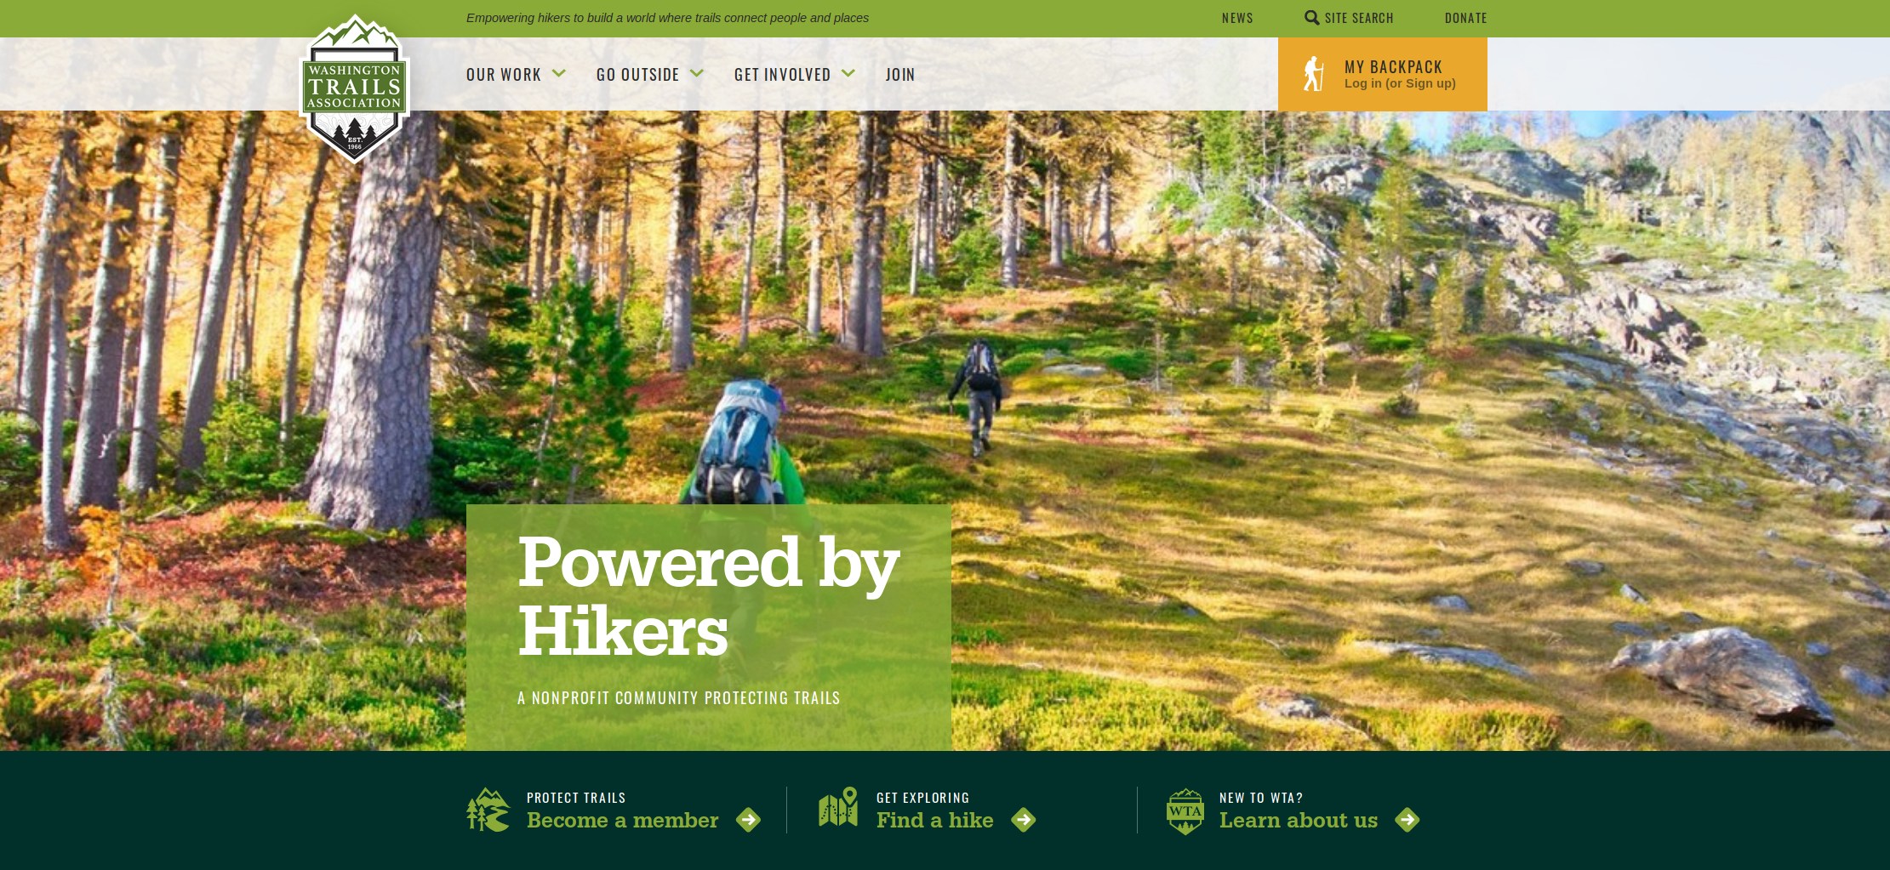
Notes:
Main page of website
Looks good

Slide 4
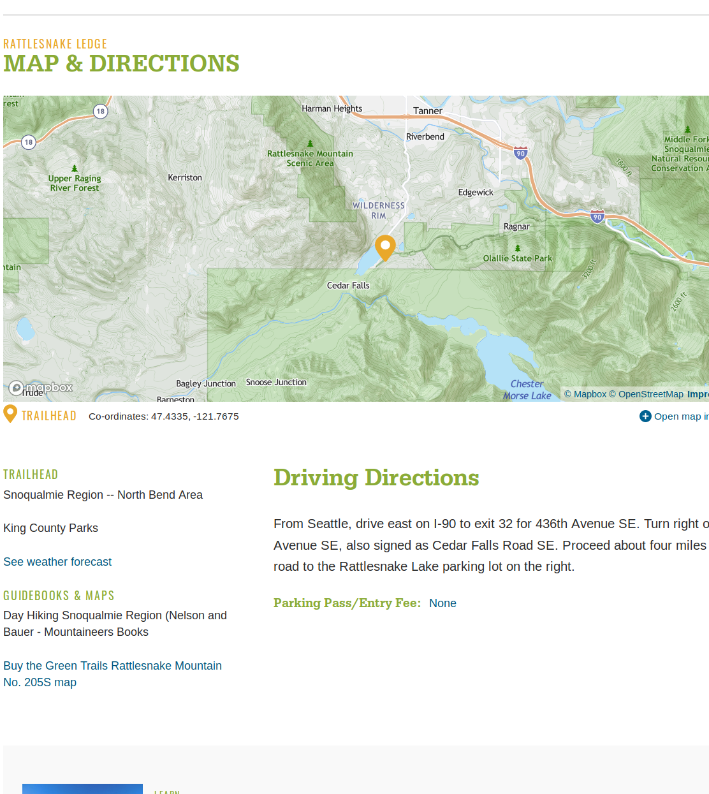
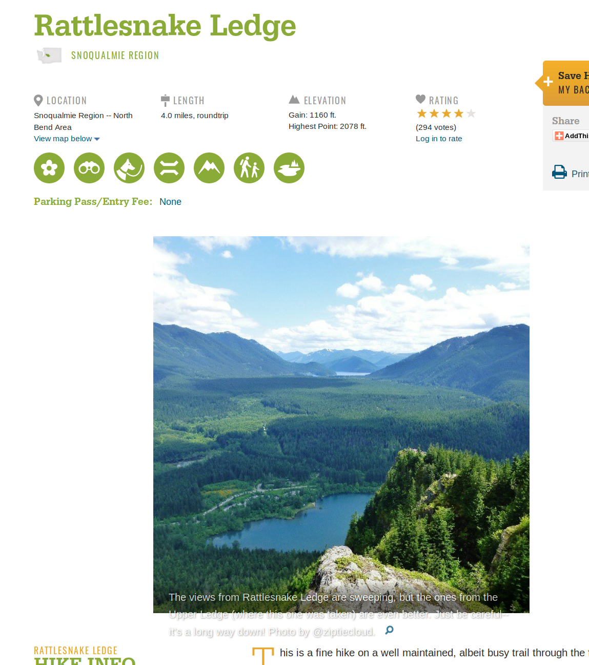

Slide 5
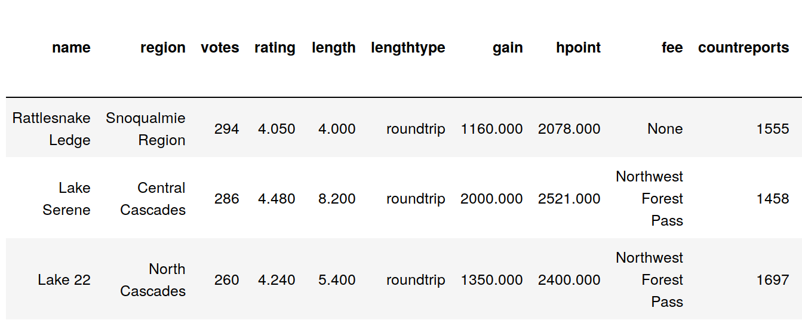
Data
3,555 total hikes
Filtered to 1,015
24 features
Notes:
Scraped into workable table
Cut some variables
Cleaning
Missing values
Incorrectly populated
Duplicates flowing other fields
One way vs round trip
Final set down to < 30% of total hikes

Slide 6
Continuous
Standardize
Combine
Categorical
Encode
Notes:
Consider cooler shapes (split could be a lightning bolt?) Modeling could be recycling arrows.
Evaluate could be a paper

Slide 7
Continuous Features
Feature | Unit
Trip Report | Count
Length | Miles
Starting Elevation | Feet
Elevation Gain | Feet
Notes:
Different Scales → Standardization (mean of 0 and std dev of 1)

Slide 8
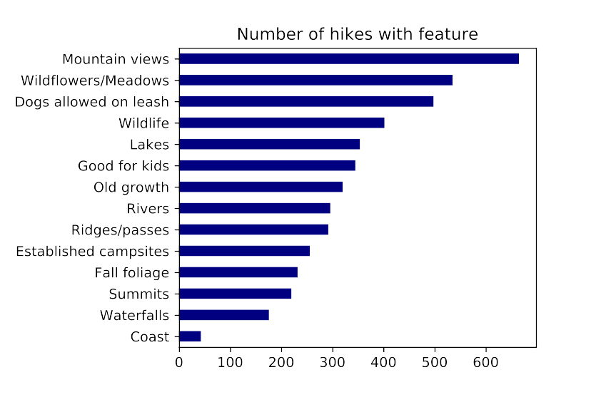
Categorical Features
11 Regions
Unique
7 Fee / Pass types
Potentially overlapping
14 “Present” Features
Waterfalls, Coast, Summit view, Dog-friendly, etc
Notes:
One-Hot Encoding

Slide 9
Continuous
Standardize
Training
Modeling
Split!
Combined
Evaluate
Categorical
Encode
Testing
Notes:
Consider cooler shapes (split could be a lightning bolt?) Modeling could be recycling arrows.
Evaluate could be a paper

Slide 10
Results
Best model incorporated a 2nd degree polynomial
Regularization improved further
Provides insight, but not much predictive value
Regularization Model | Test R² Score | Test/Train R² Difference
Lasso | .17 | .06
Ridge Regression | .17 | .17
Elastic Net (L1 = 0.1) | .22 | .04
Notes:
Slight R^2
L1 Elastic = Mostly Ridge Regression, a little bit of lasso

Slide 11
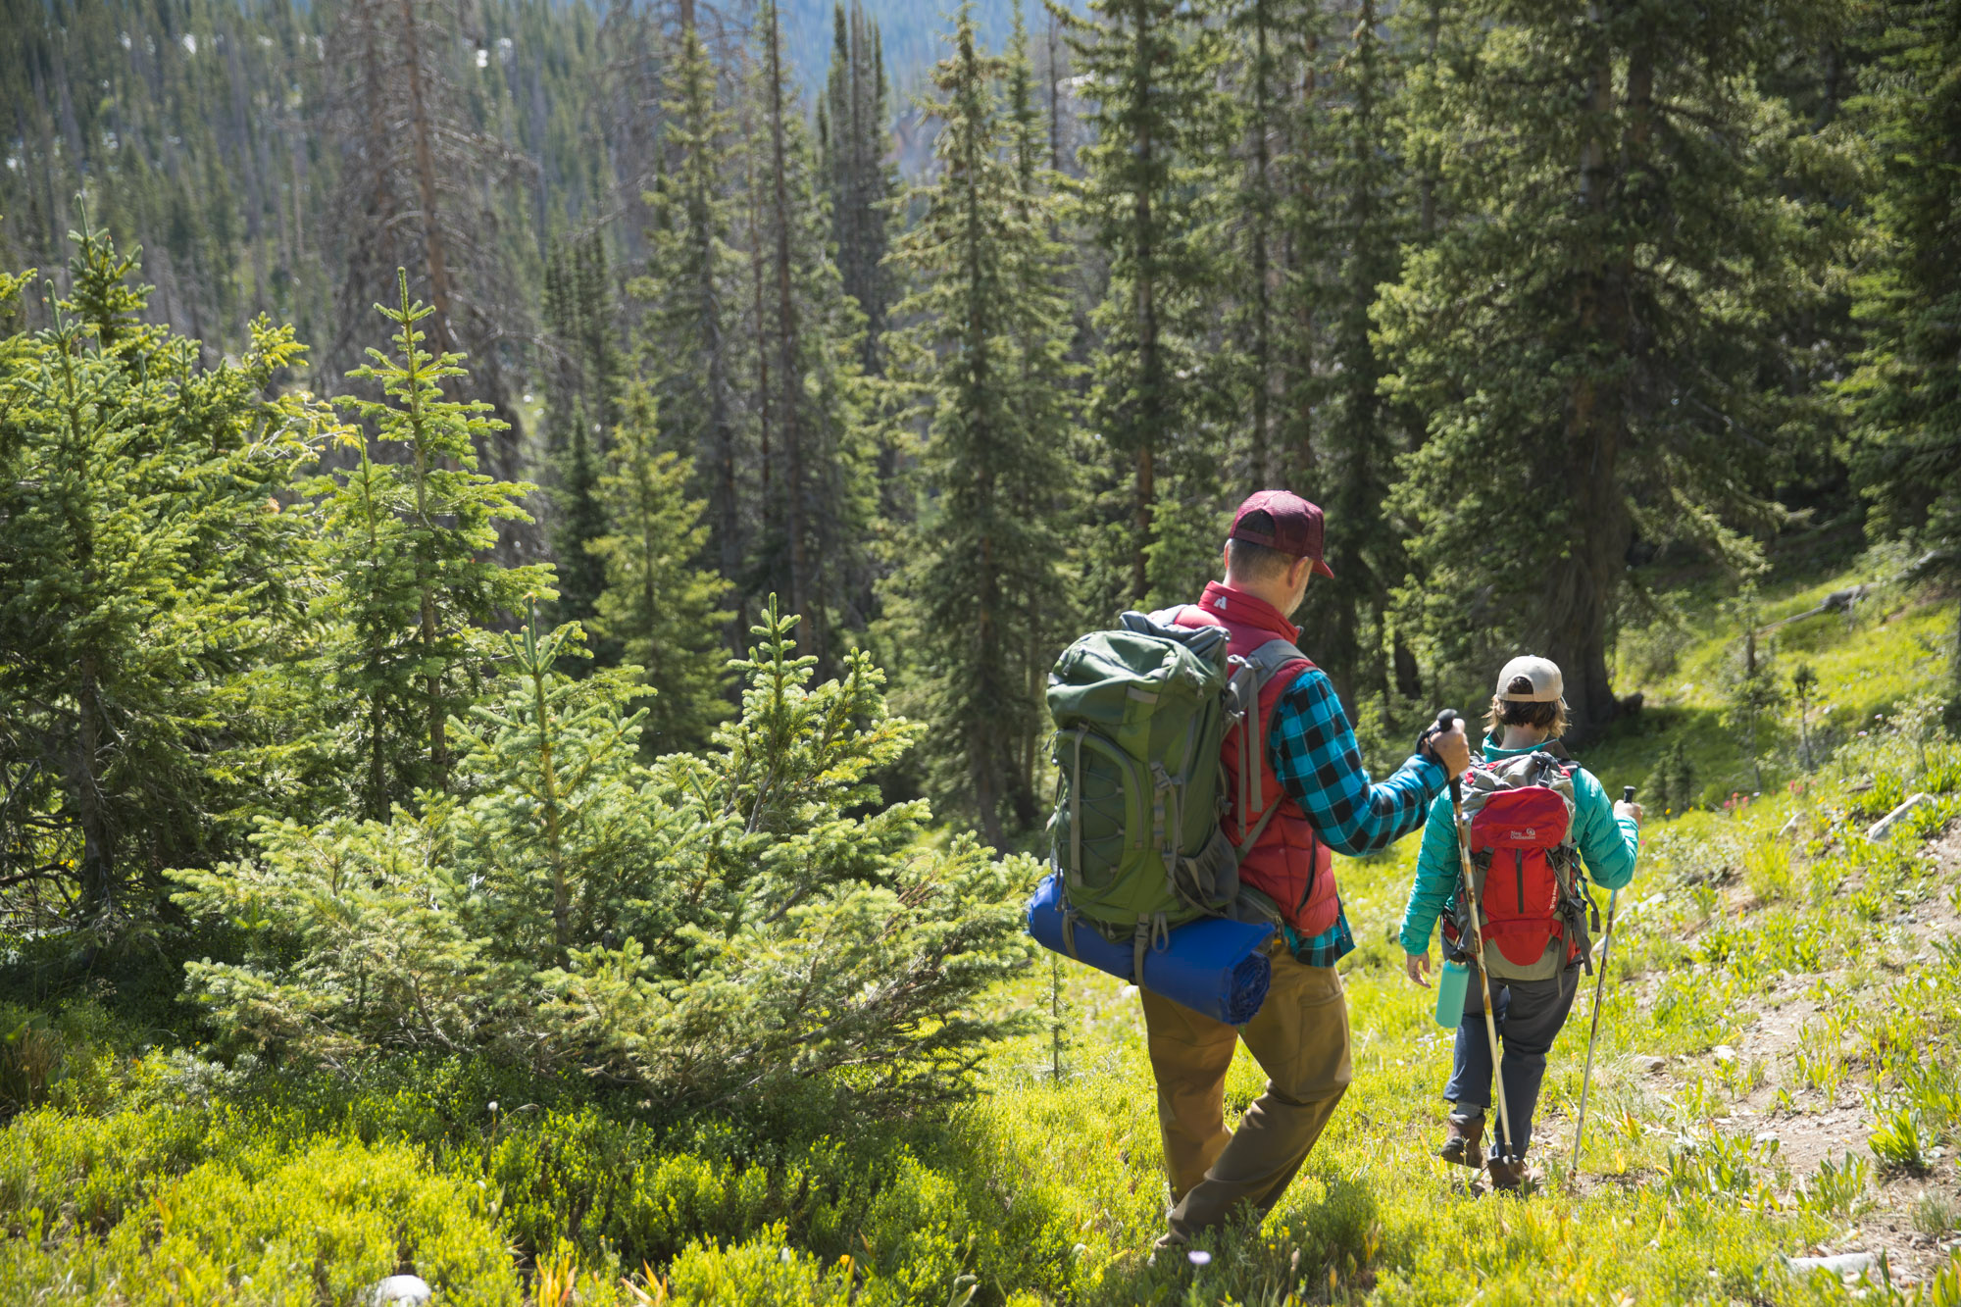
Conclusion
Model is not great at predicting hikes
Some over-fitting
Better than chance
“Rating” isn’t best metric
Notes:
Not great
Gap between train and test R²
Missing features
Rating only represents people who take the time to go online afterward, know of the website, then vote. Pro or novice hiker?

Slide 12
Future work
More features
Trail maintenance, reputation, weather on day of vote, NLP of trip reports
Other data sources
Predict something other than “rating”
Predict popularity of hike on a given day
Analyze “type” of hiker
Amateur / Experienced / Likely to post online
Notes:
Pop on given day:
Weather
Day of week / holiday
Time of year

Slide 13
Questions?

Slide 14
Appendix

Slide 15
Continuous
Encode
Training
Modeling
Split!
Combined
Evaluate
Categorical
Standardize
Testing
Notes:
Consider cooler shapes (split could be a lightning bolt?) Modeling could be recycling arrows.
Evaluate could be a paper

